Slide 1

Case Study 2
Jobin Joseph

Slide 2

Problem
We the company of DDSAnalytics have been selected to conduct talent management research to the help with insights about employees at the Frito Lay corporation.

Slide 3
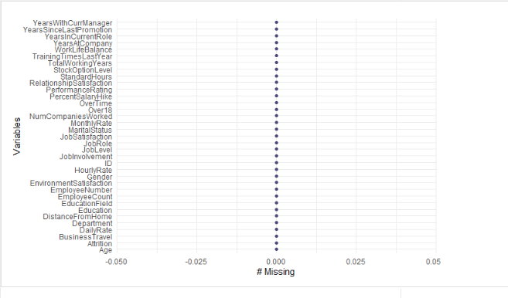
We were provided a data set called CaseStudy2-data.csv there are 870 observations and 36 variables
CaseStudy2CompSet NoAttrition.csv
CaseStudy2CompSet No Salary.csv .
Notes:
We were provided a data set called CaseStudy2-data.csv there are 870 observations and 36 variables. Using a function of .na were able to find that the data set contained no missing varibles. In order to test our predictions CaseStudy2CompSet No Attrition.csv and CaseStudy2CompSet No Salary.csv were provided to test our models.

Slide 4
Some Helpful Insights
Notes:
The following slides we will present some helpful insights We were able to produce using different variables in the data set that was provided.

Slide 5
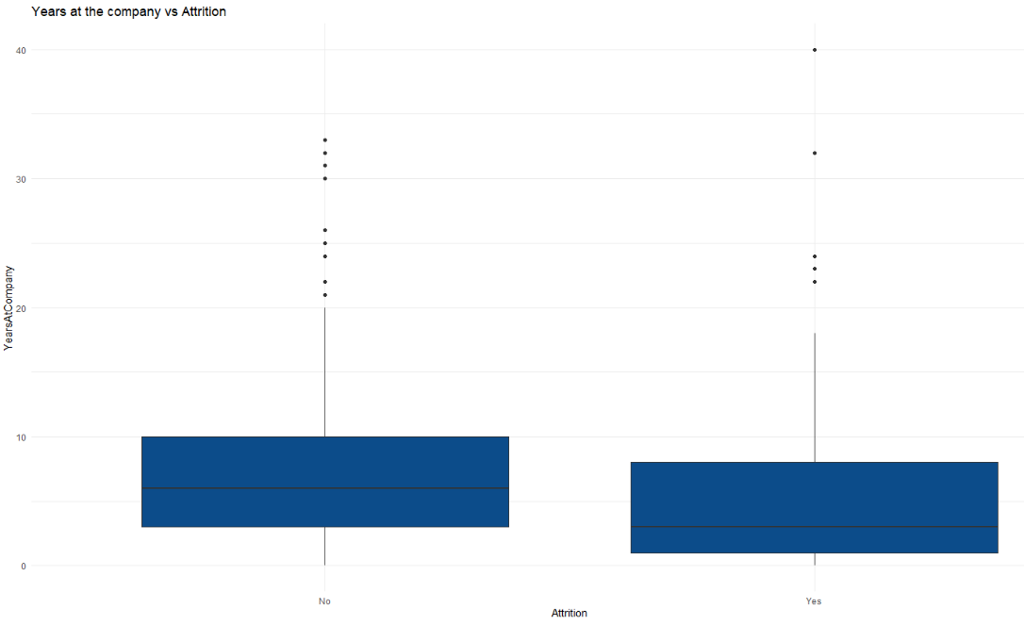
Notes:
Here we can see that the higher the years an employee worked at the company the lower the likelihood of them leaving.

Slide 6
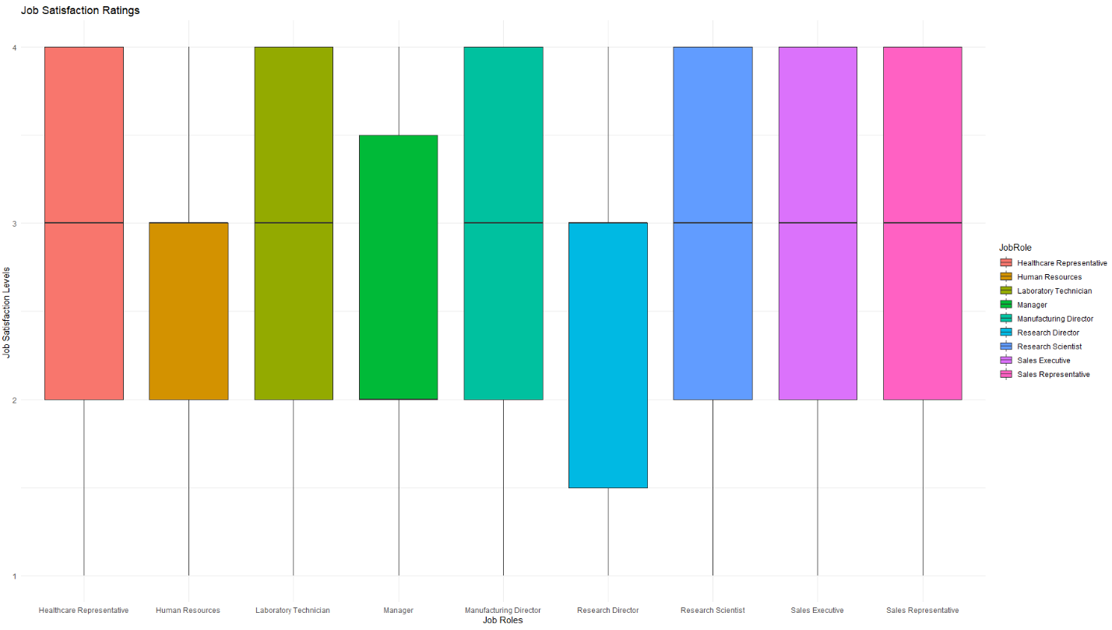
Notes:
In this boxplot graph we can see that working in the human resources and research director roles can lead to lower job satisfaction levels. Which might in turn have an effect on attrition.

Slide 7
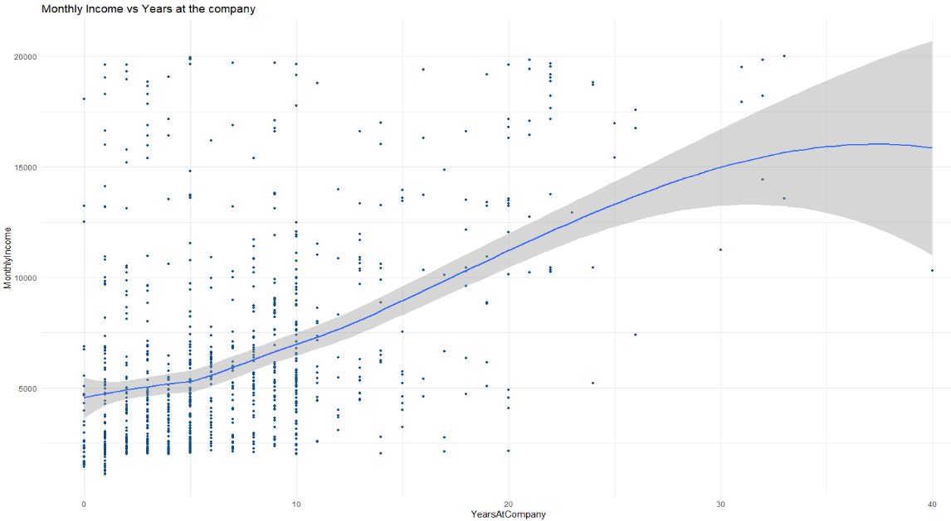
Notes:
By plotting monthly income vs years at the company we can see generally the more years at the company the more the employee gets paid but we have to be careful as this varies more after 25 years at working in the company

Slide 8
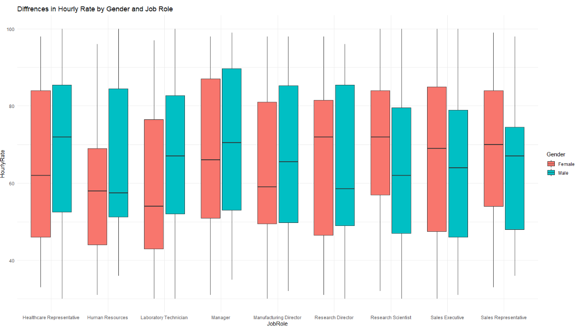
Notes:
We can see at each respective job role generally women tend to get have a lower mean hourly rate. This should probably be addressed as this can lead to PR issues for the company later .

Slide 9
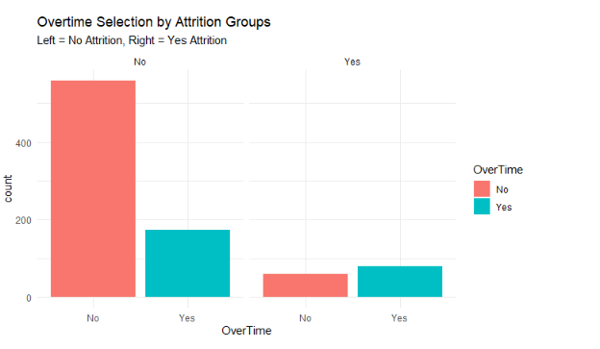
Notes:
In this plot we can see that employees that tend to stay with the company generally tend to do less Overtime . This is the opposite of employees who leave the company.

Slide 10
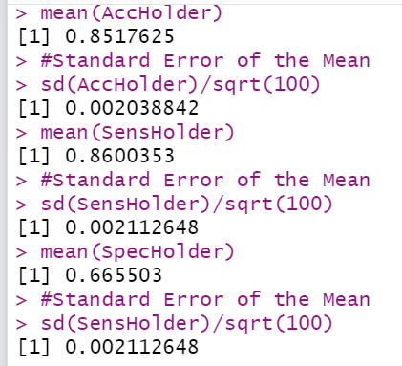
Naive Bayes
Using the naive Bayes method DDSAnalytics was able to find a classifier model that would predict with the factors of Age, Job Role, Job Satisfaction, and OverTime
Accuracy of the model is 0.8517625
Specificity of the model is 0.8600353
Sensitivity of the model is 0.665503
Notes:
This method was used to predict if there would be attritions per employee in the no attrition set. These predictions were put in a new file called case2predictions Jobin Joseph Attrition

Slide 11
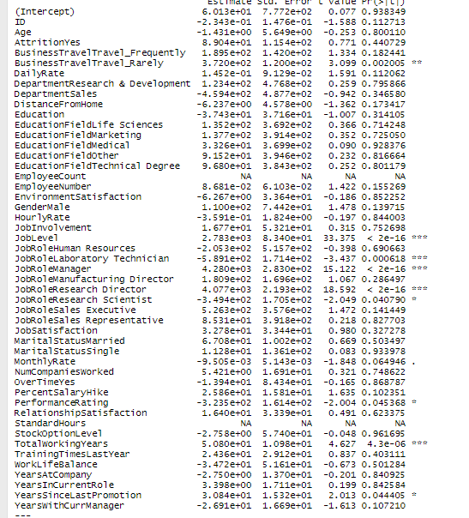
Linear regression model
In order to find clues on what explanatory variables were needed for the predictions error to be lower
Notes:
The lower the p value the more significance it has on monthly income

Slide 12
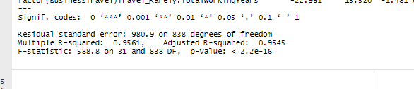
Linear regression model
The model that I went with was
Monthly Income = Business Travel + JobLevel + JobRole + TotalworkingYears + YearsSinceLastPromotion +PerformanceRating + TotalworkingYears*JobLevel + TotalworkingYears* JobRole + TotalworkingYears* BusinessTravel
Notes:
This linear method was used to predict salary of employees in the no salary set. We can see that the model has a RSME of 980.9 These predictions were put in a new file called case2predictions Jobin Joseph Salary

Slide 13

Conclusion
In conclusion we at DDSAnalytics hope Frito Lays will utilize our models for drawing inferences when making decisions in the future of the employees.

Slide 14
Thank You!

